Slide 1
Powers out, what do you do
Saginaw County ARES

Slide 2
Power Outage
A power outage is when the electrical power goes out unexpectedly.
It can be local, a neighborhood or a wide area.
Extended power outages may impact the whole community and the economy.

Slide 3
Power Outage
What affect may an extended power outage have on a community?

Slide 4
A Power Outage May -
Disrupt communications, water and transportation.
Close retail businesses, grocery stores, gas stations, ATMs, banks and other services.
Cause food spoilage and water contamination.
Prevent use of medical devices.
What can you do to prepare?

Slide 5
Power Outage – First Thing
Have a plan!
Don't wait till the lights go off to start your plan or think about what needs to be done.
Second - Notify your utility company.
Most Utility companies can estimate the time for restoration. Is this going to be a short-term event or may last several hours or days?
How widespread is the outage?
Power Company Outage Map
Adjust your plan as time goes on.

Slide 6
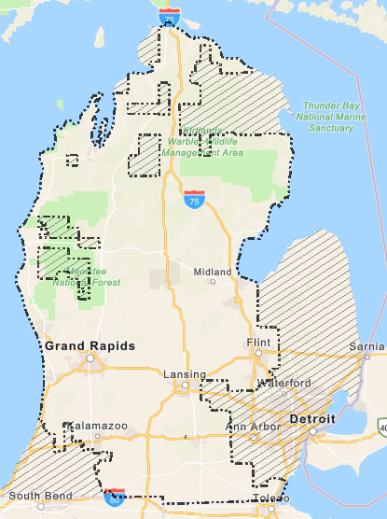
Power Outage
Consumers Outage Map

Slide 7
Preparing for a Power Outage
Take an inventory of the items you need that rely on electricity.
Plan for batteries and other alternative power sources to meet your needs when the power goes out, such as a portable charger or power bank.

Slide 8
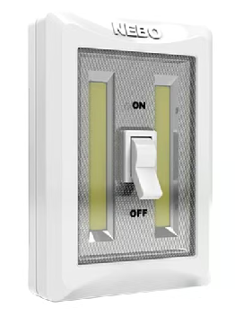
Preparing for a Power Outage
Have flashlights for every household member.
Determine whether your home phone will work in a power outage and how long battery backup will last.

Slide 9
Using Appliances durining a Power Outage
Install carbon monoxide detectors with battery backup in central locations on every level of your home.
Avoid carbon monoxide poisoning.
Generators, camp stoves or charcoal grills should always be used outdoors and at least 20 feet away from an opening.
Never use a gas stovetop or oven to heat your home.
Turn off or disconnect appliances, equipment, or electronics.
Power may return with momentary surges or spikes that can cause damage.

Slide 10
Food Storage
Have enough nonperishable food and water.
Keep freezers and refrigerators closed.
The refrigerator will keep food cold for about four hours. A full freezer will keep the temperature for about 48 hours.
Use coolers with ice if necessary.
Monitor temperatures with a thermometer.
Throw out food if the temperature is 40 degrees or higher.

Slide 11

Know your Medical Needs
Talk to your medical provider about a power outage plan for medical devices powered by electricity and refrigerated medicines.
Find out how long medication can be stored at higher temperatures and get specific guidance for any medications that are critical for life.

Slide 12
Heating/Cooling
If it is winter, how will you keep your house warm?
Fireplace
kerosene fuel heaters
Furnace?
In summer how will you keep you cool?
Open windows
That subterranean level
Fans if you have an alternative power source
Outside under trees or other shaded areas

Slide 13
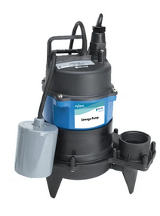
That new pool in your basement
Don’t forget the Sump Pump
Battery backup
Water pressure backup
Generator

Slide 14
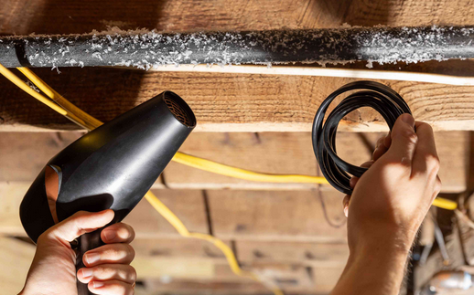
Keeping those pipes warm
If the outage is in winter, how to your keep your pipes from freezing?
Insulation
Never try to thaw a pipe with a torch or other open flame.
When power comes back on, use a hair dryer to try and thaw pipes.

Slide 15

Meals
How will you prepare meals while the power is out?
Gas stove
Charcoal or gas grill
That fire pit in the backyard
Alternative food sources
MRE’s
Emergency food supply

Slide 16
Alternative Power Sources

Slide 17
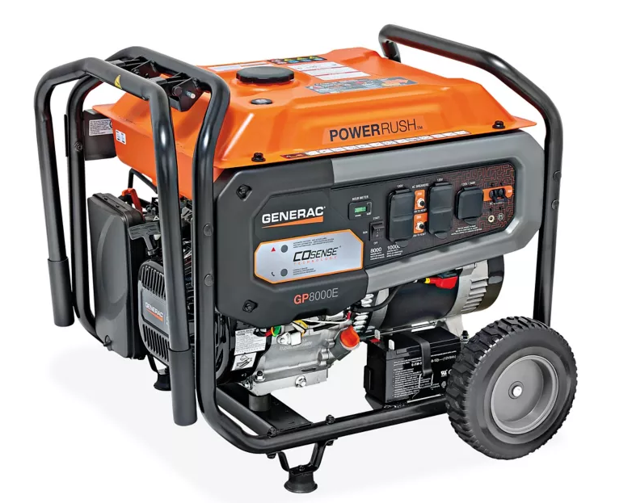
Alternative Power Sources
Generator
Generators are handy in a power outage but may be deadly. They should be at least 20 feet away from doors or windows.

Slide 18
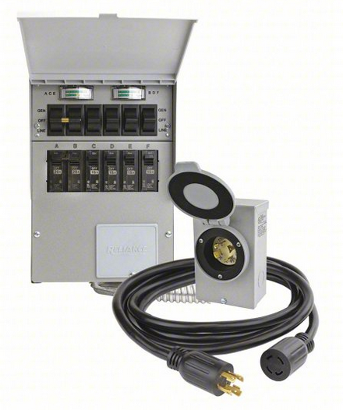
Alternative Power Sources
Transfer Switch
Having a transfer switch installed is a good idea. Being able to plug in your generator to an outside connector and supplying multiple circuits in your home makes things much simpler and safer.

Slide 19
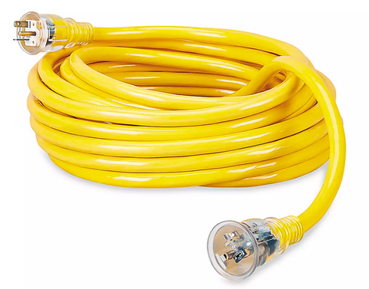
Alternative Power Sources
Extension cords
Make sure you are using the correct extension cord for the device it is suppling power too.
Don’t overload your generator – load level
Back feed?

Slide 20
Alternative Power Sources
Whole House Generator
If you are prone to power outages a whole house generator may be the best solution.
Solar/Battery
Wind/Battery
These are other alternative power sources, but it requires a larger up-front expense and may not be zoned for your area.

Slide 21
Alternative Power Sources
Other things to consider:
Fuel for generator
Securing your generator
Protecting your generator
Keeping your vehicles fuel filled
Siphon hose

Slide 22
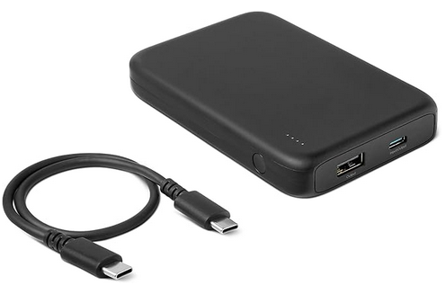
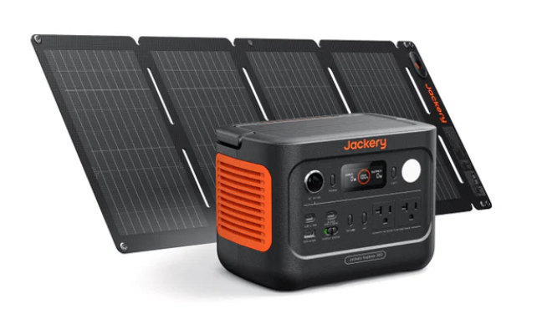
Power Sources
Small Power Bank
Portable Power Station

Slide 23
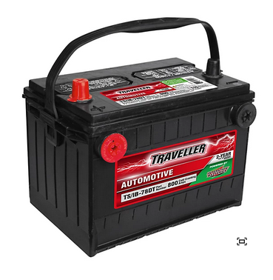
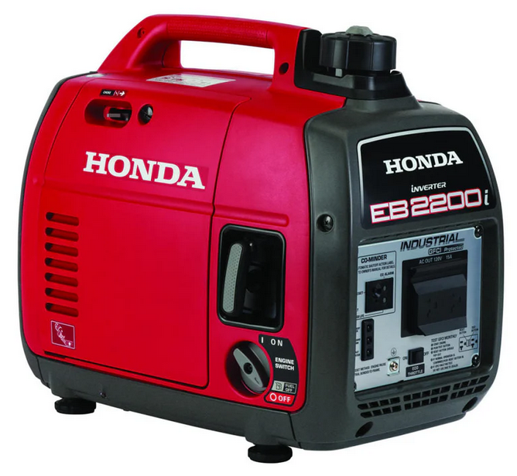
Power Sources
RV Type deep cycle battery
Generator

Slide 24
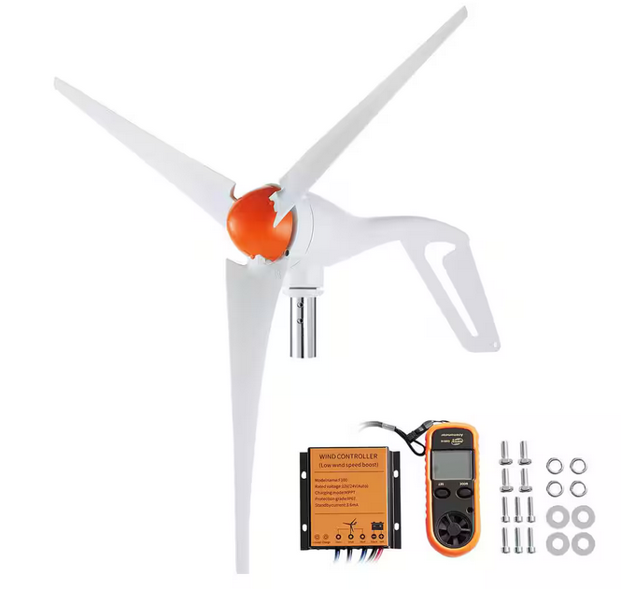
Power Sources
Wind Generator

Slide 25
Communications

Slide 26
Communications
House phone
Cell phone
Ham Radio
GMRS/FRS Radio
CB Radio
Meshtastic devices
Radio
TV
Weather radio

Slide 27
Communications
During an outage, your cell phone is your lifeline and you’re likely to want to keep it charged in case of an emergency.
Because you can’t depend on your phone indefinitely, write down phone numbers and addresses you might need, such as a nearby hospital, a school that’s providing supplies, the local library or storm shelter, or other public places that might have power—places where you’ll be able to go to recharge your electronics and contact loved ones.

Slide 28
Communications
What if the power is going to be out for a lengthy time or covers a wide area? The local cell tower that covers your area my not function.
How will you communication if your cell phone does not have service?

Slide 29
Communications
How will you contact your family and friends?
Check on your neighbors

Slide 30
Alternative Living Spaces

Slide 31
That Camper in your Driveway
That camper in your driveway may have an onboard generator or alternative power source.
May offer better living conditions then your home.

Slide 32
Evacuation

Slide 33
Evacuation
You may have to evacuate your house because of the outage. What do you do then?
Turn off the main breaker or switch of the circuit-breaker panel or power-supply box.
Turn off the water main where it enters the house.
Drain the water from your plumbing system.
If you drain a gas-fired water tank, the pilot light should be turned out
If your house is protected from groundwater by a sump pump, clear valuables from the basement floor in case of flooding.
Evacuation Go Kits

Slide 34
Power Outage Tips
Make a plan
Keep freezers and refrigerators closed.
Use a generator, but ONLY outdoors and away from windows and doors.
Do not use a gas stove or oven to heat your home.
Disconnect appliances and electronics to avoid damage from electrical surges.
Have alternate plans for refrigerating medicines or using power-dependent medical devices.
Check with local officials about heating and cooling locations open near you.
Remember to check on your neighbors

Slide 35
Questions?

Slide 36
Resources
https://www.ready.gov/power-outages
https://www.redcross.org/get-help/how-to-prepare-for-emergencies/types-of-emergencies/power-outage.html
https://www.consumerreports.org/home-safety/how-to-survive-a-prolonged-power-outage-a1579830430/

