Slide 1
Portable 2m/440MHz Suction Cup Mount Antenna

Slide 2
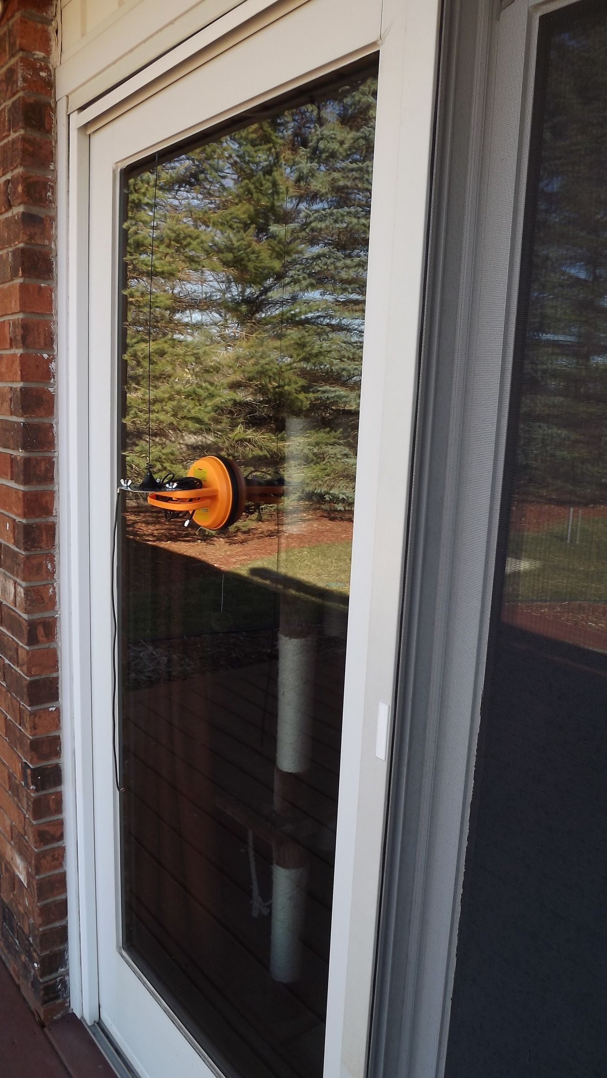

Slide 3
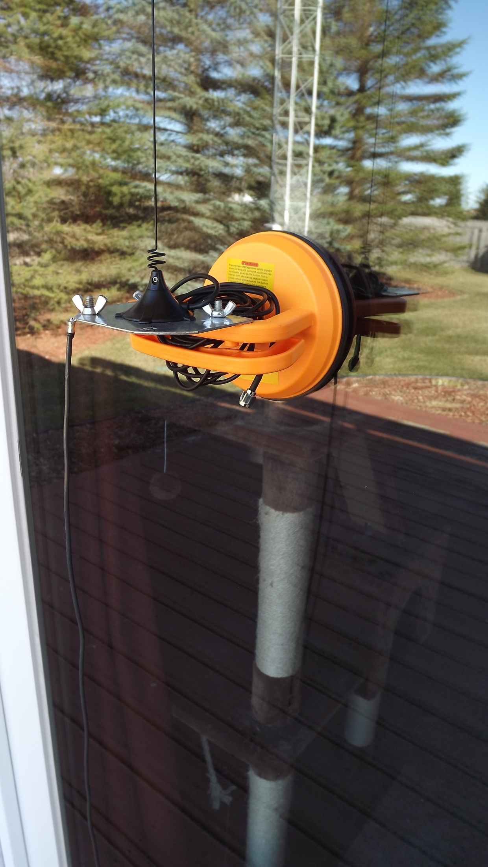

Slide 4
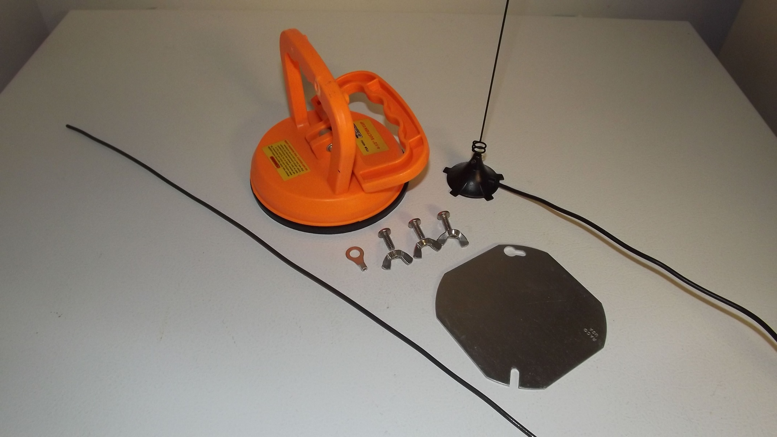

Slide 5
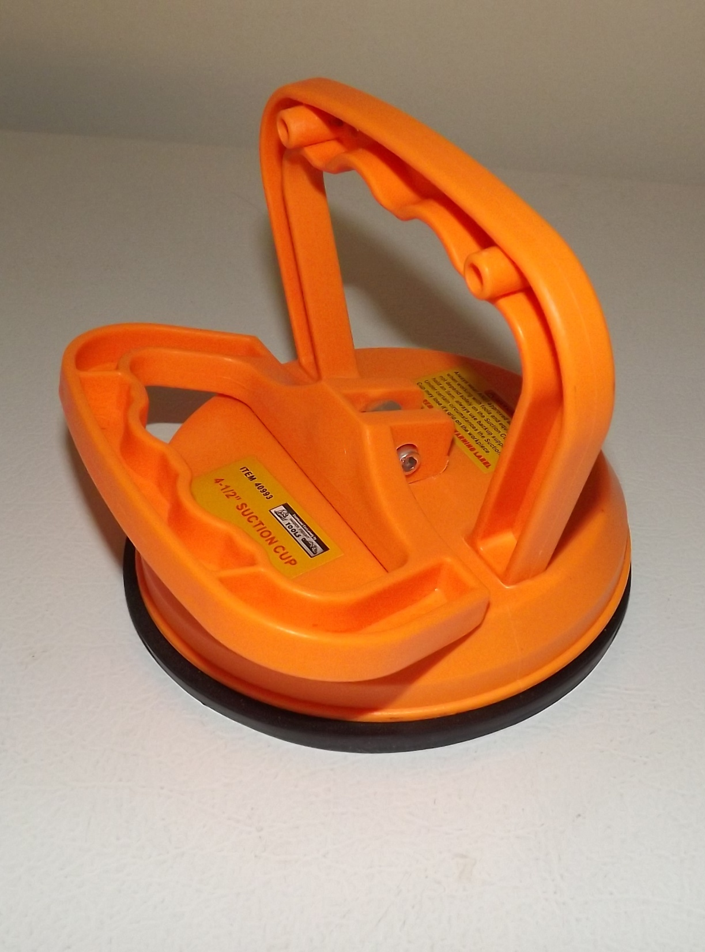
Harbor Freight 4-1/2”
Suction Cup Lifter $4.39

Slide 6
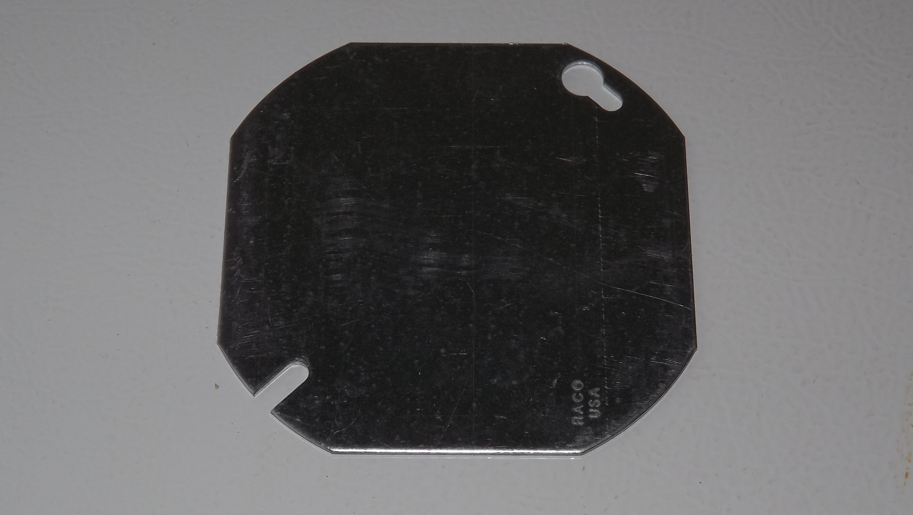
4” Octagon Electrical Box Cover

Slide 7
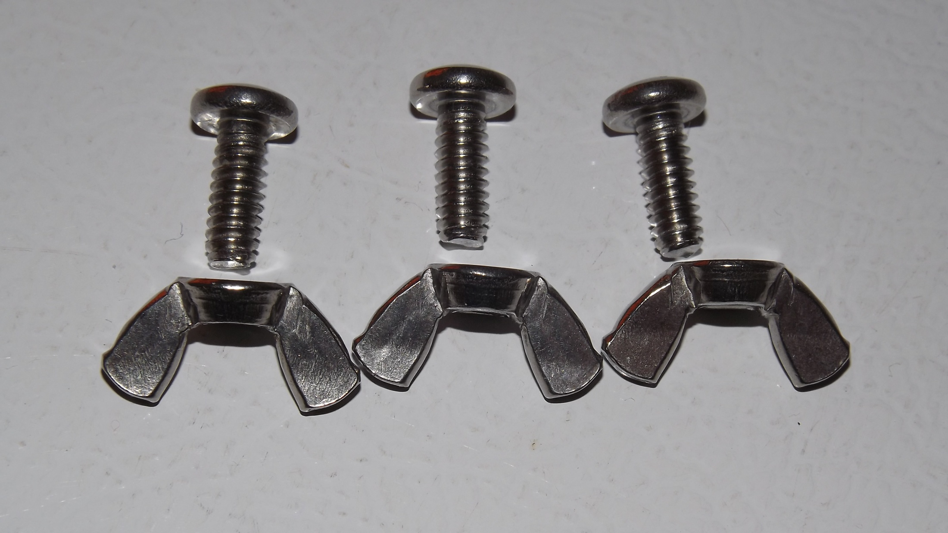
3 - #10-24x1/2” Stainless Steel
Machine Screws and Wing Nuts

Slide 8
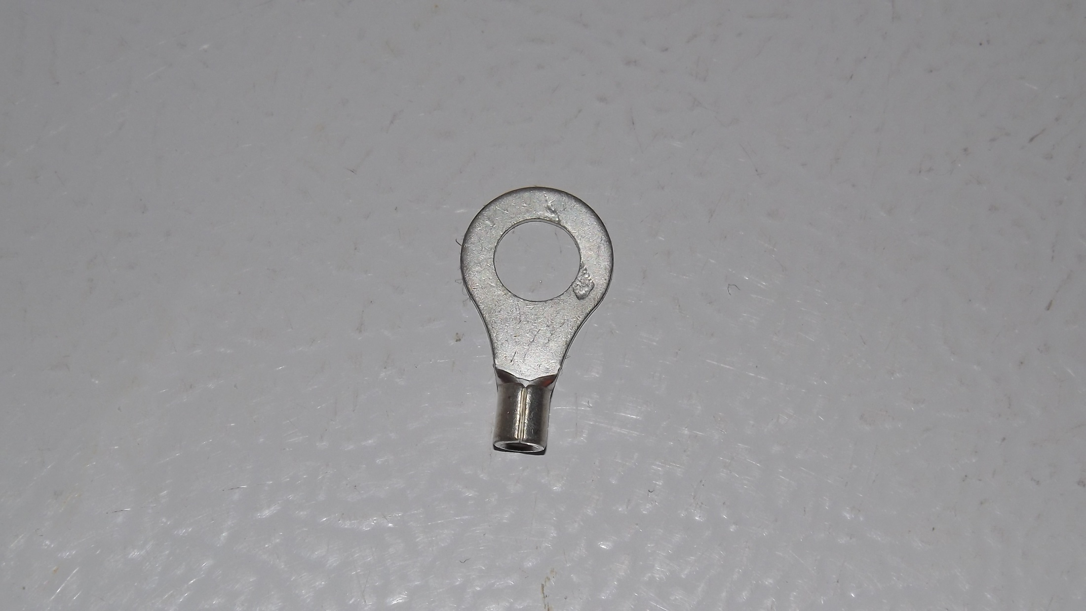
Ring Terminal

Slide 9
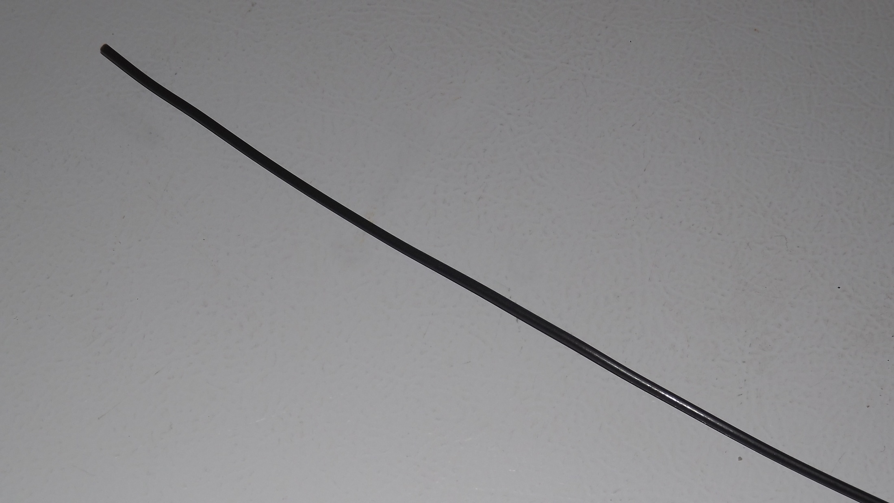
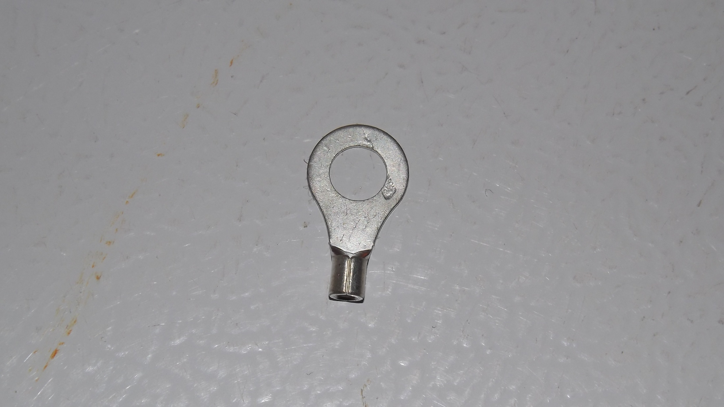
20” 12ga Solid Copper Wire
Ring Terminal

Slide 10
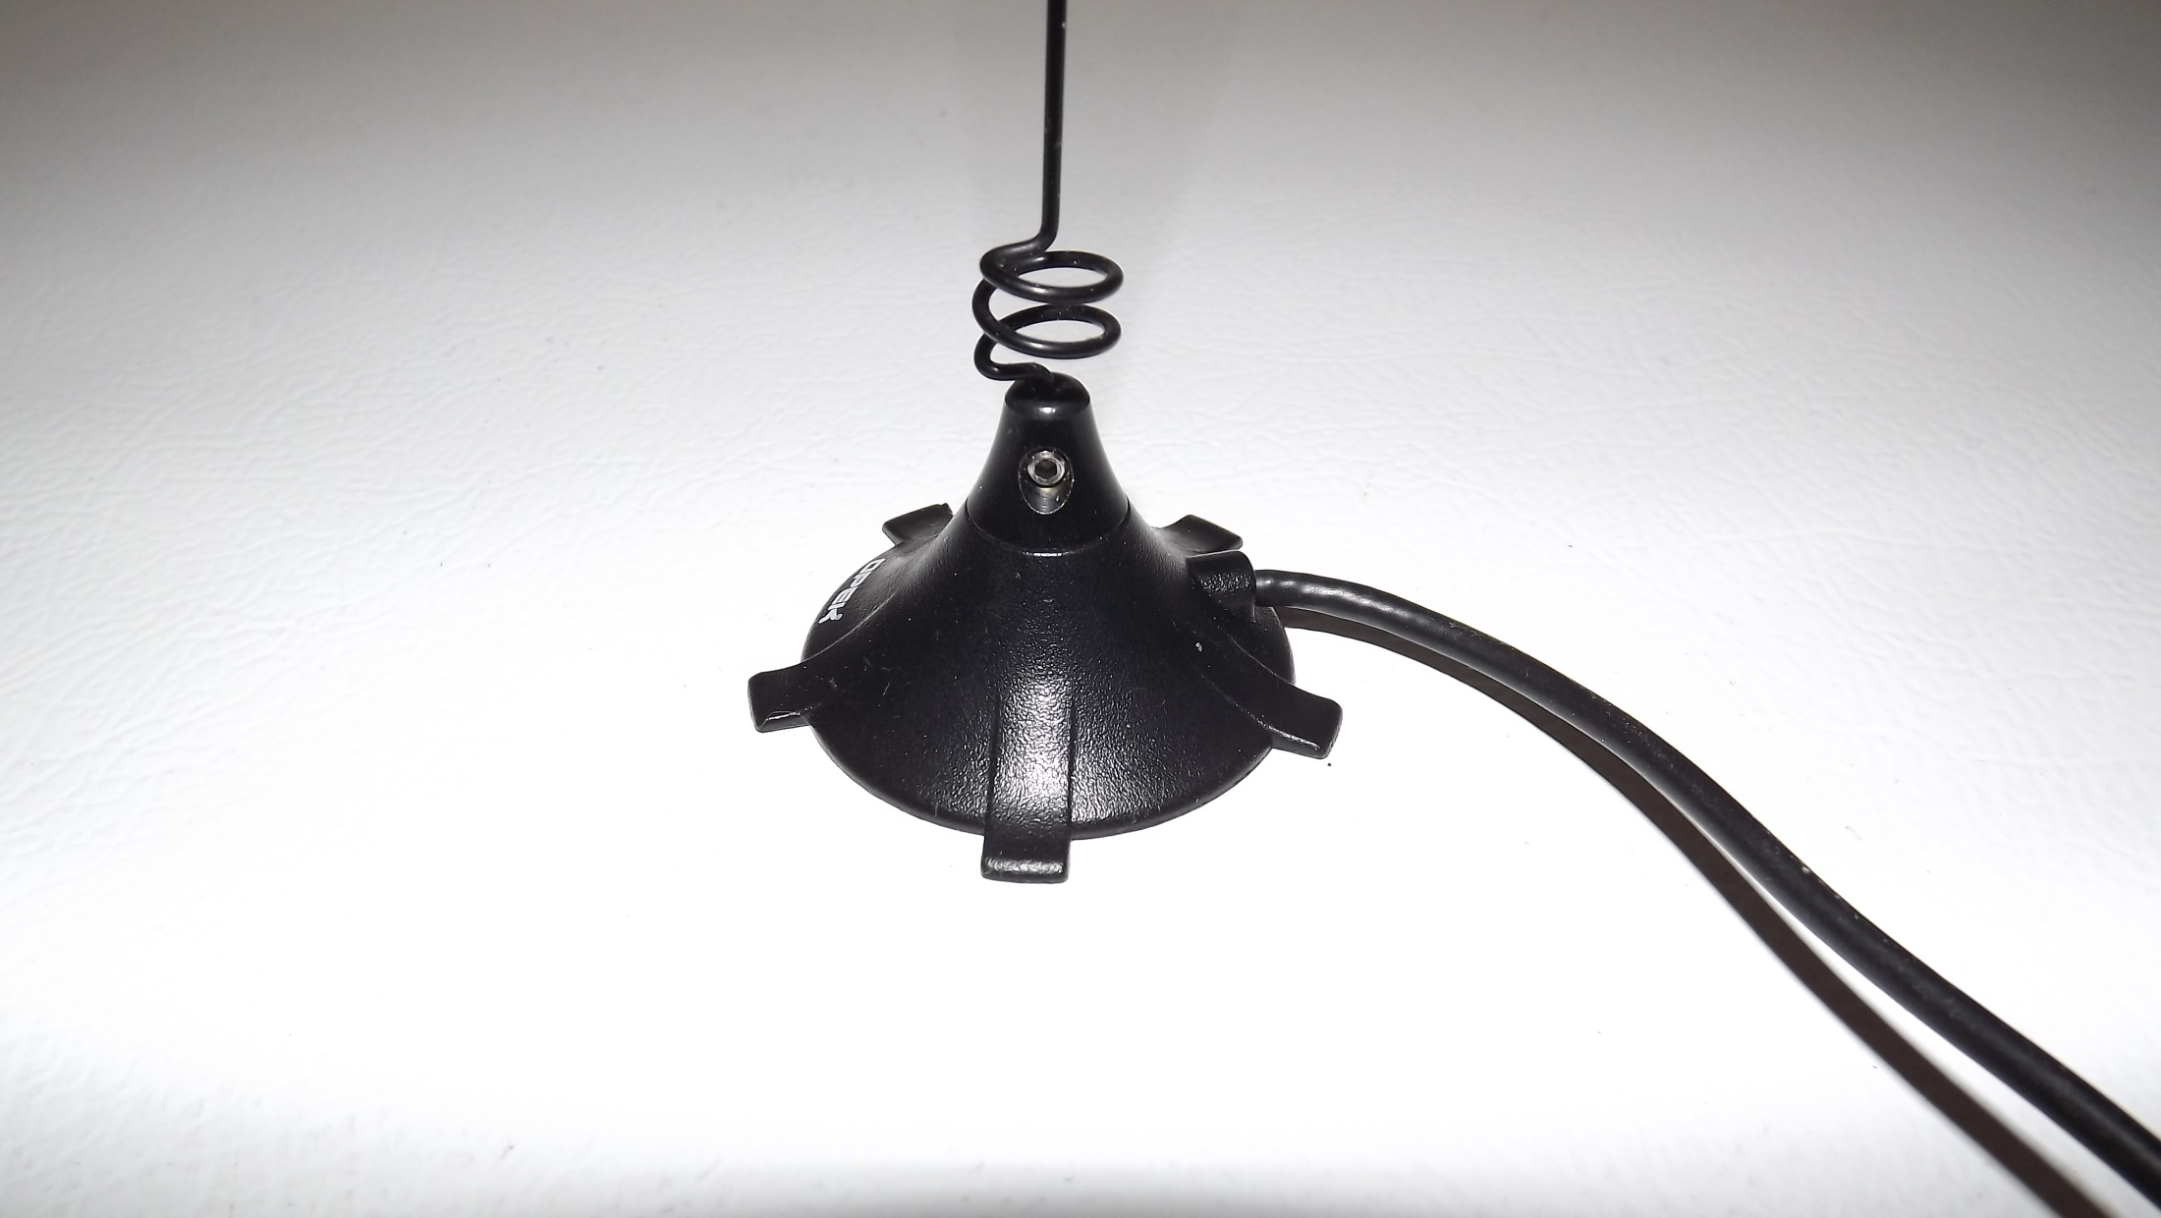
2m/440 MHz Mini Magnet Mount Mobile Antenna
Quicksilver Radio $19.73

Slide 11
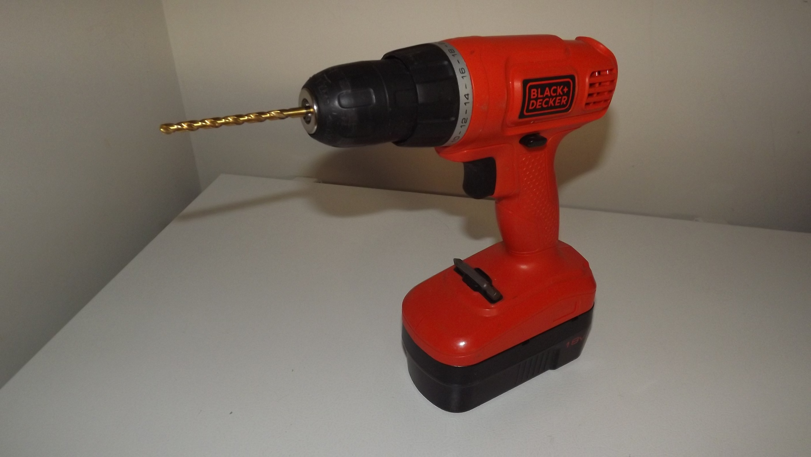
3/16” Drill Bit and Drill

Slide 12
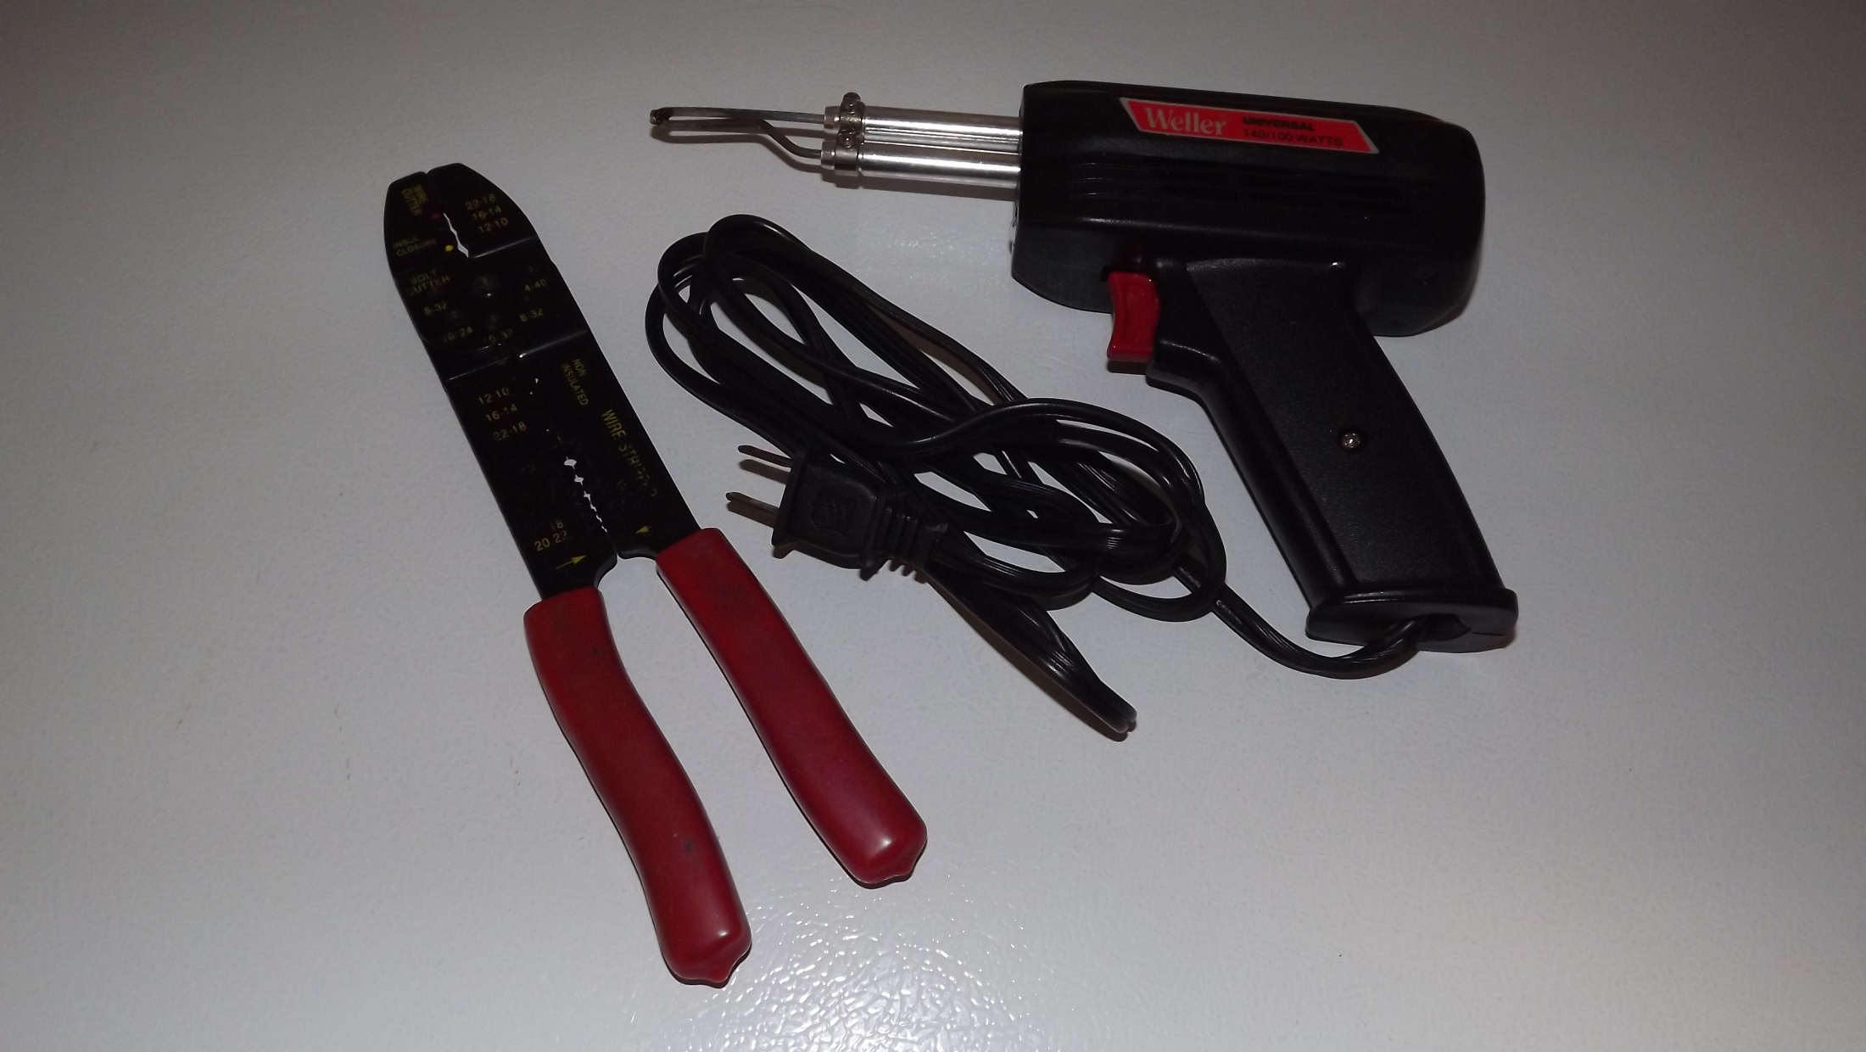
Wire Crimpers or Soldering Gun

Slide 13
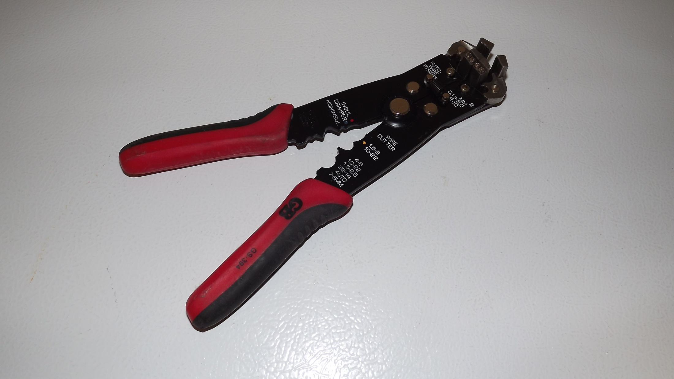
Wire Strippers

Slide 14
-----------------------------------------------------------

Slide 15
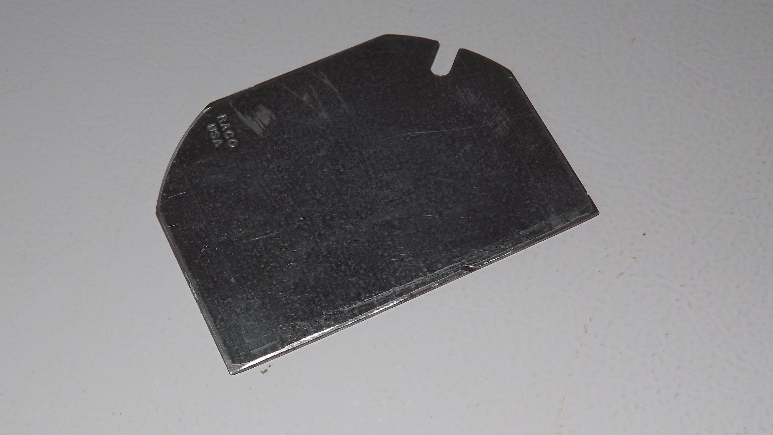

Slide 16
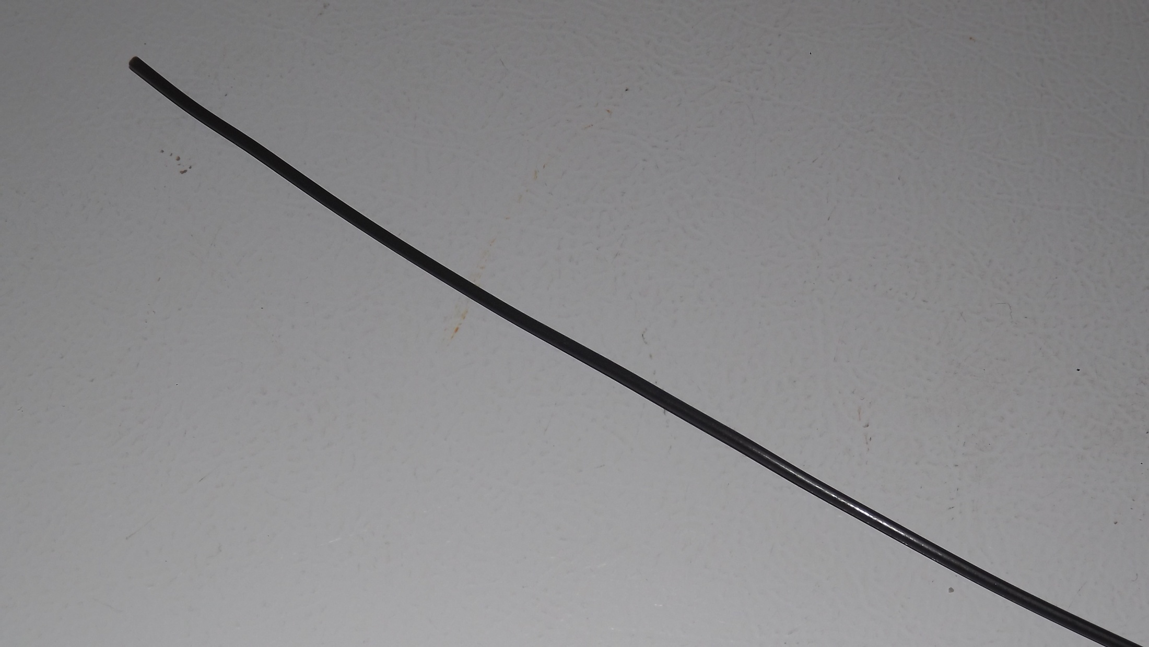

Slide 17
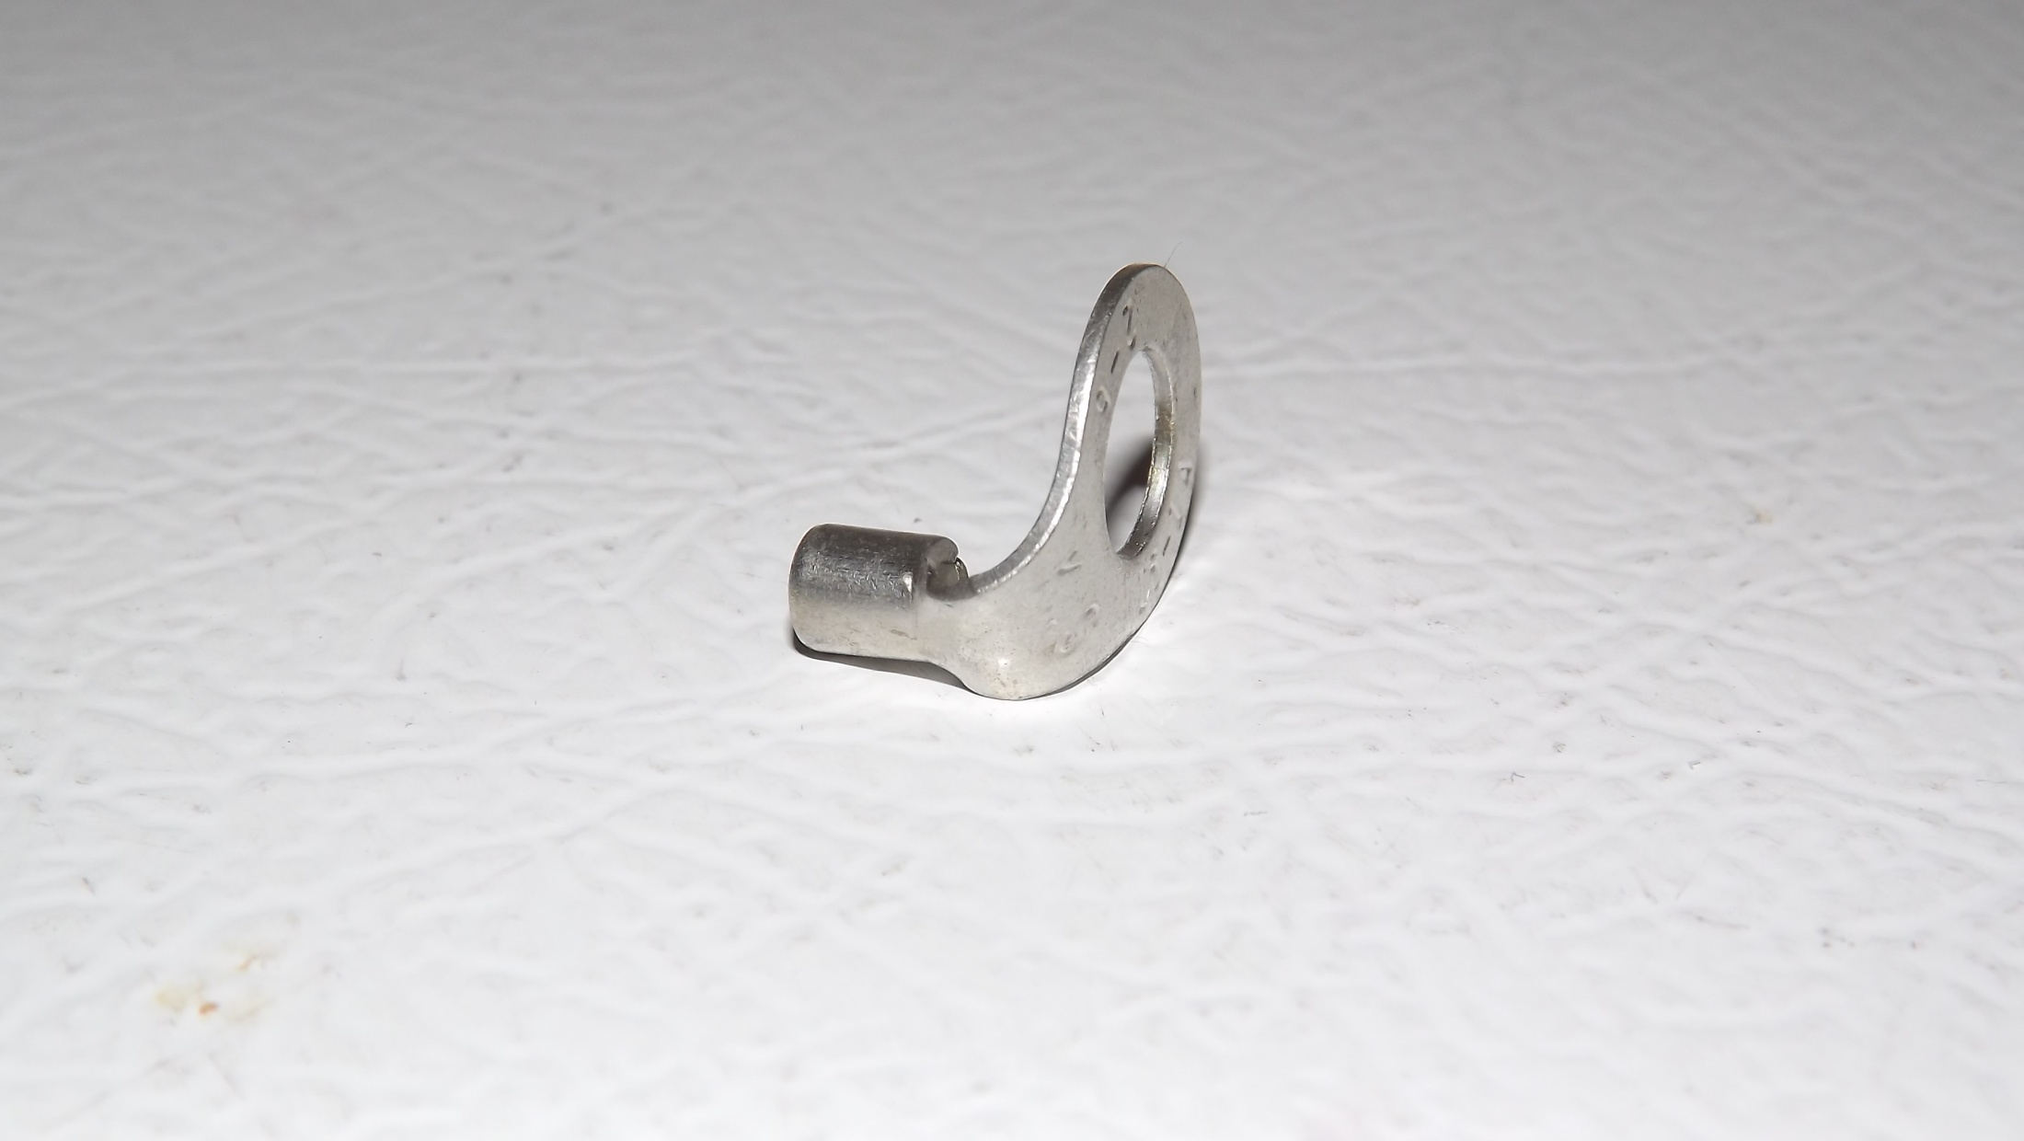
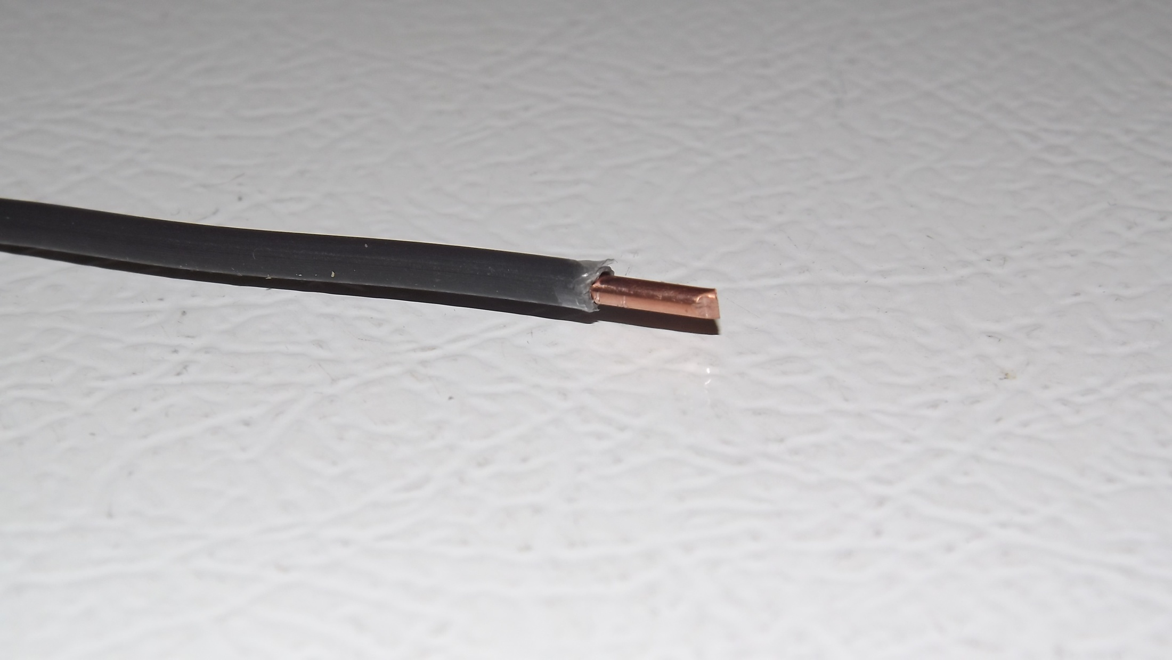
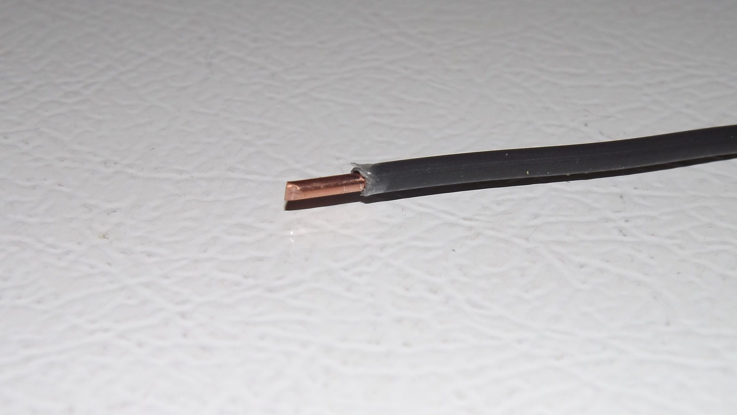
Remove ½” of insulation

Slide 18
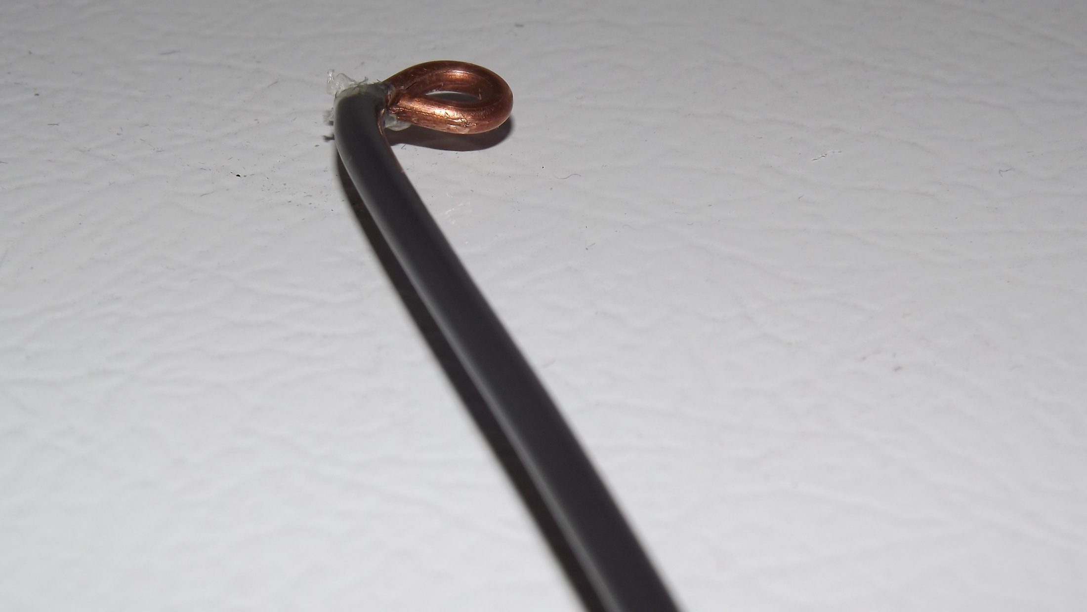

Slide 19
Remove ½” of insulation

Slide 20
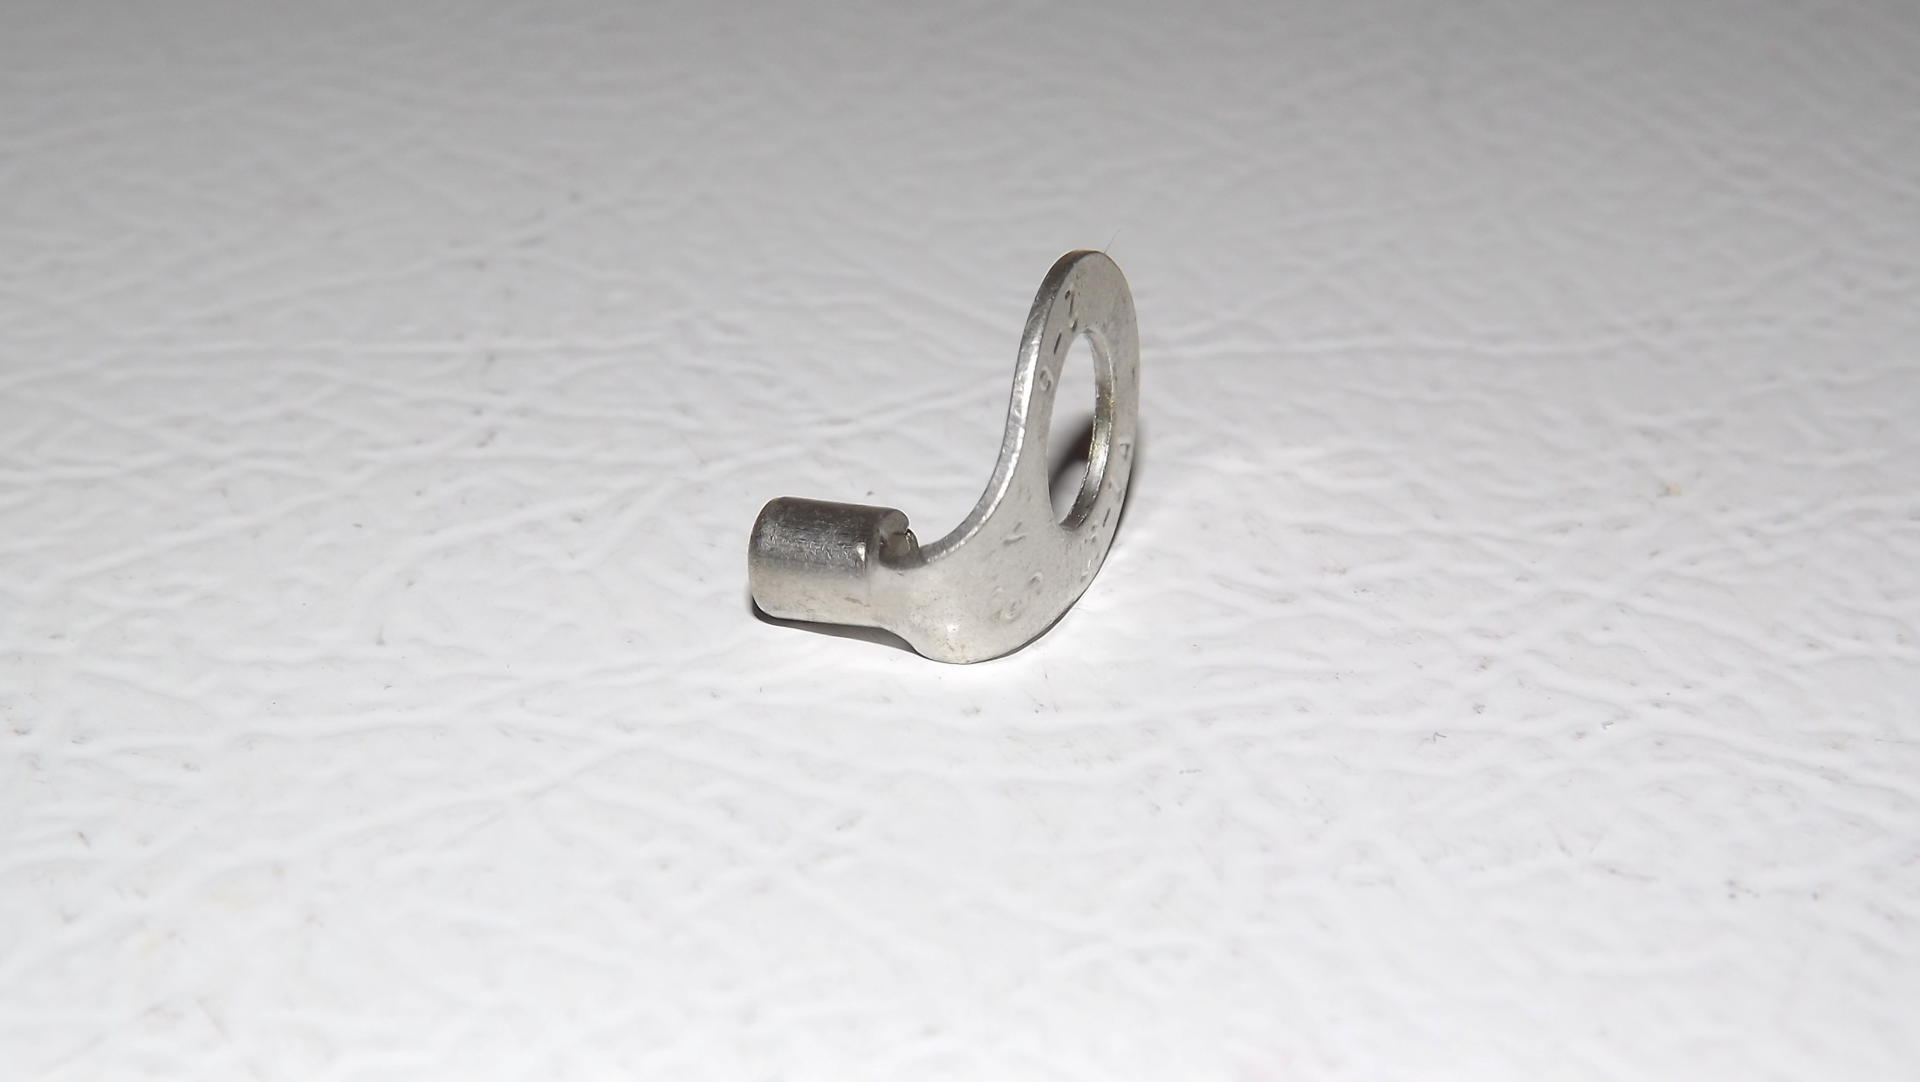

Slide 21
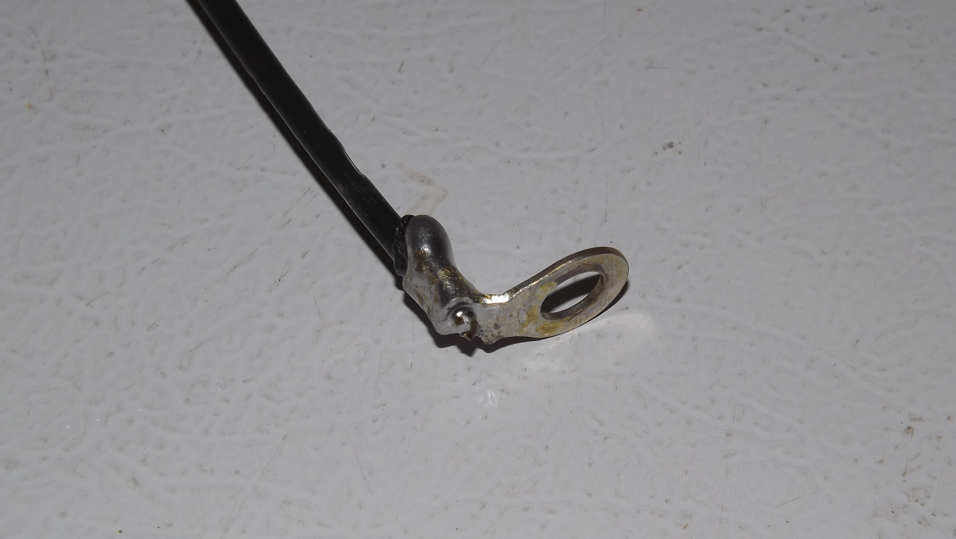

Slide 25
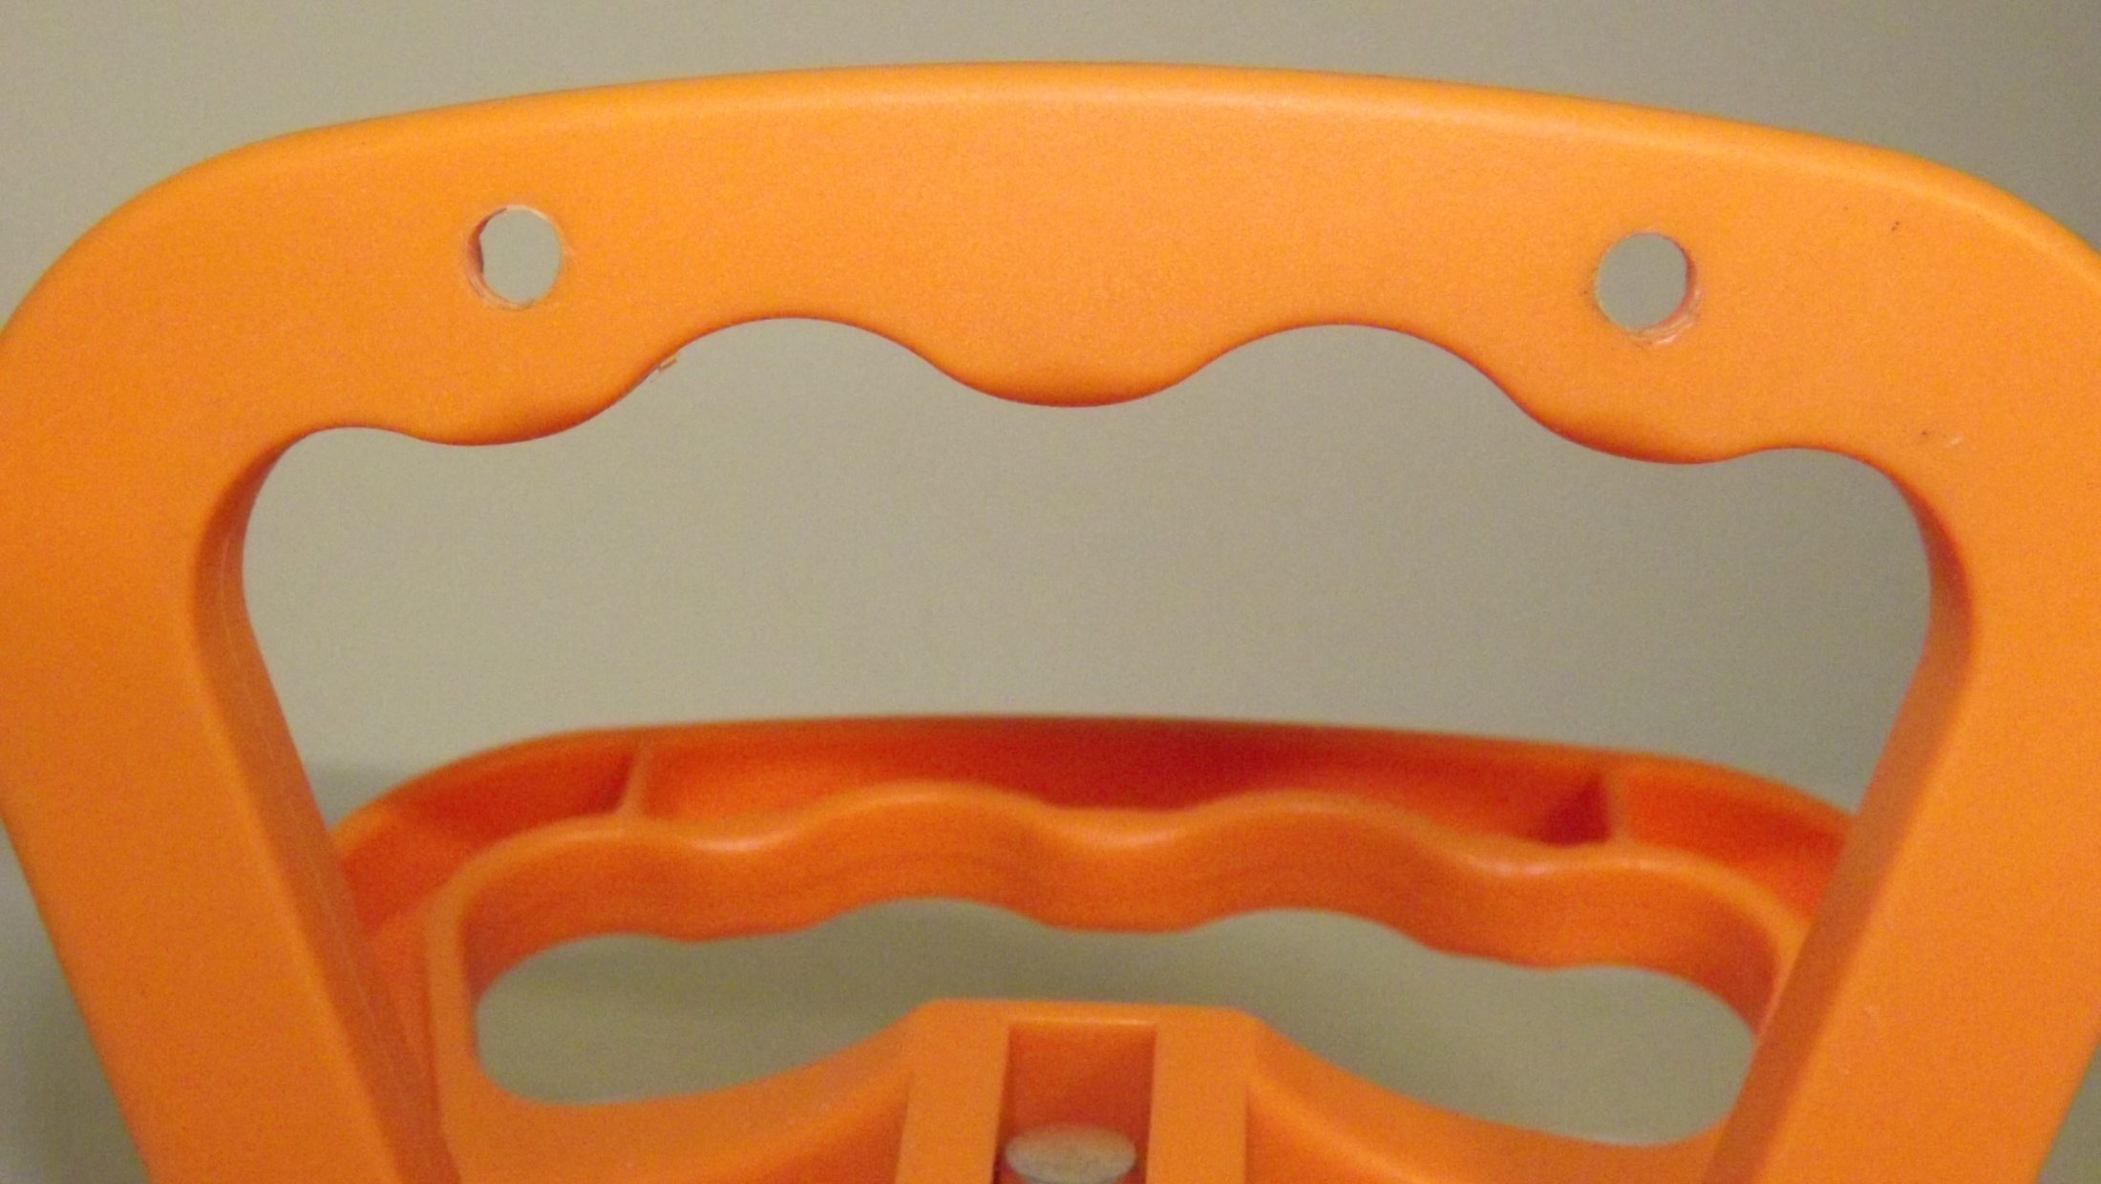
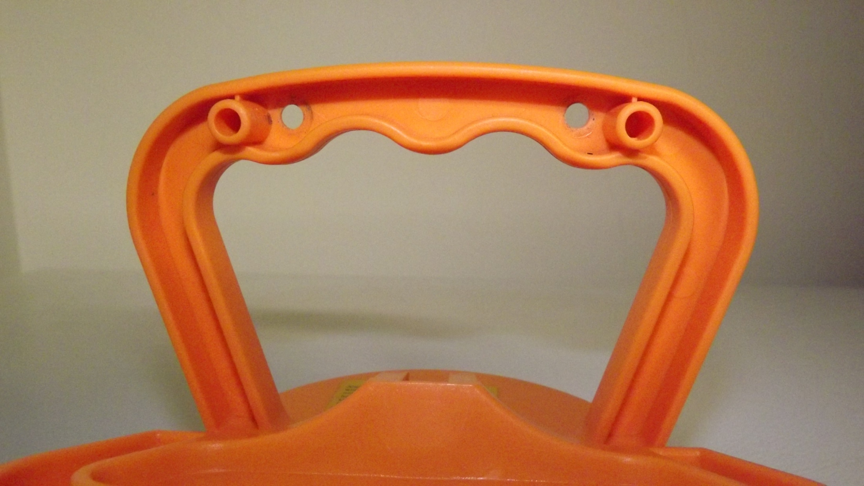

Slide 26
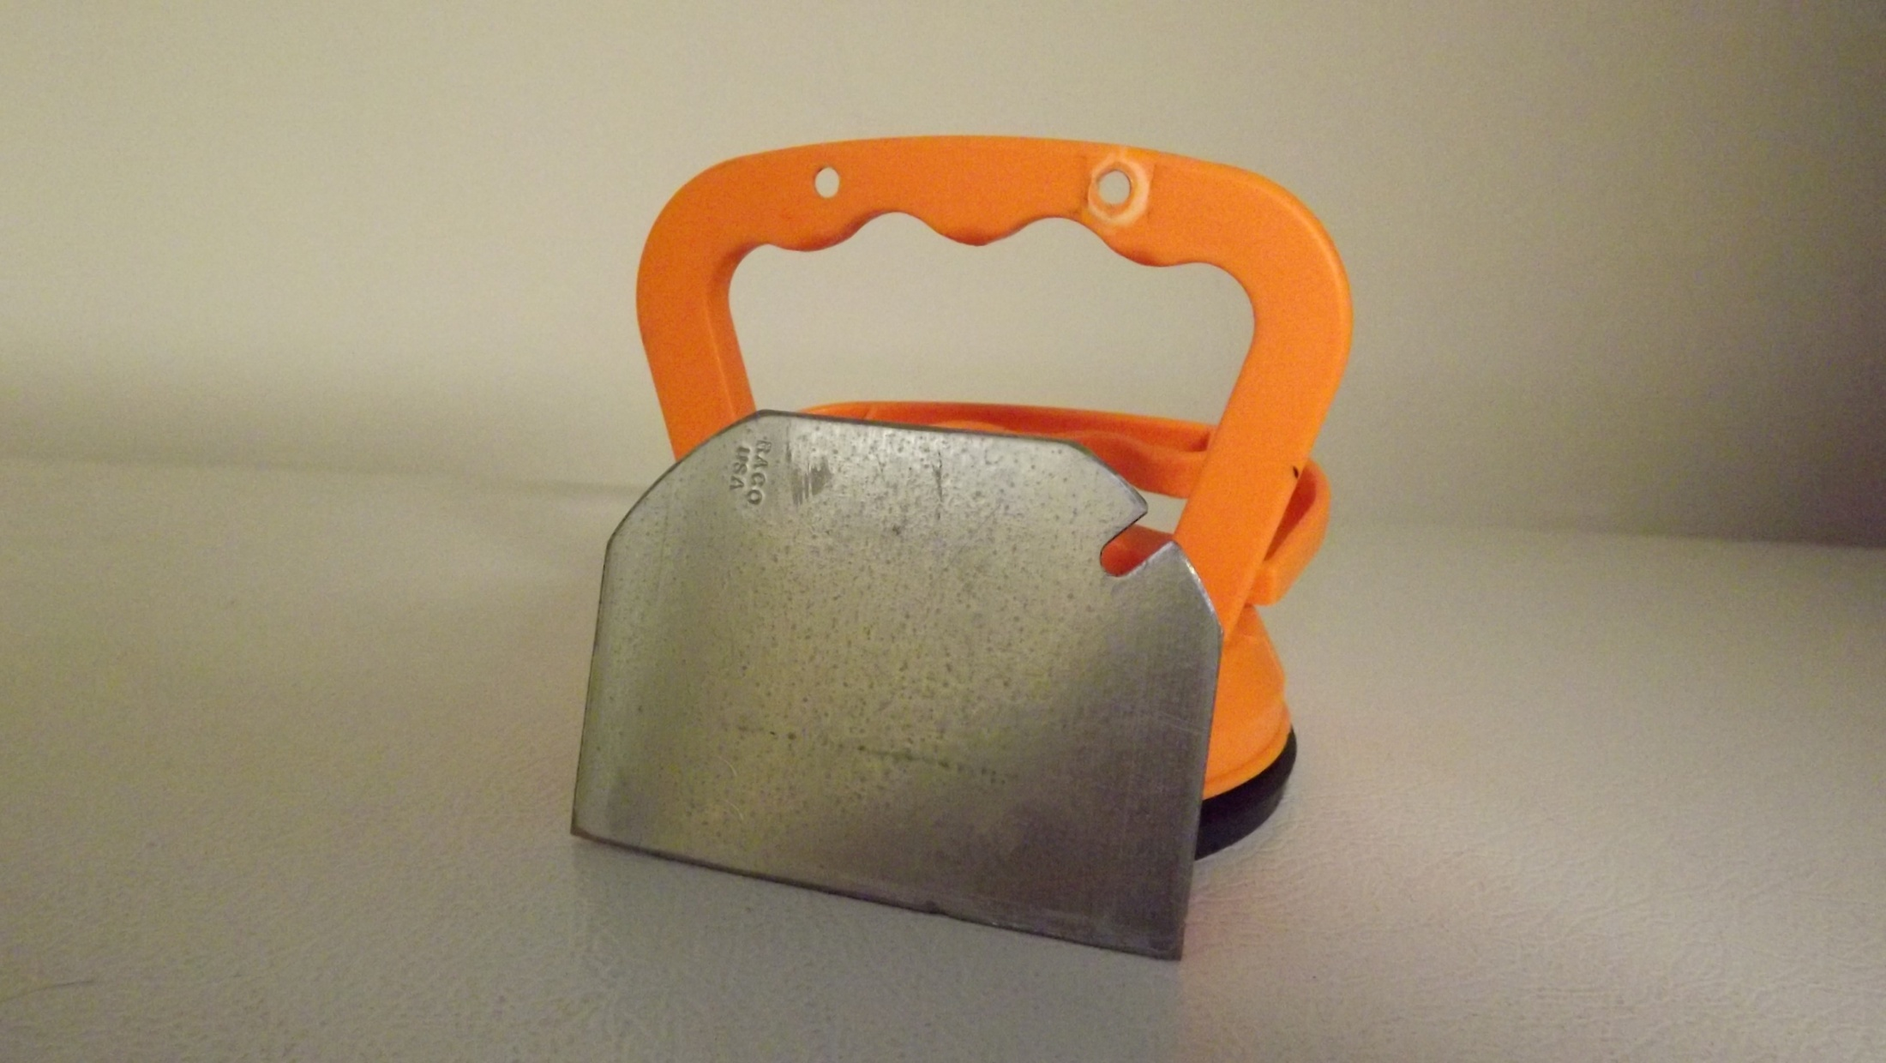

Slide 27
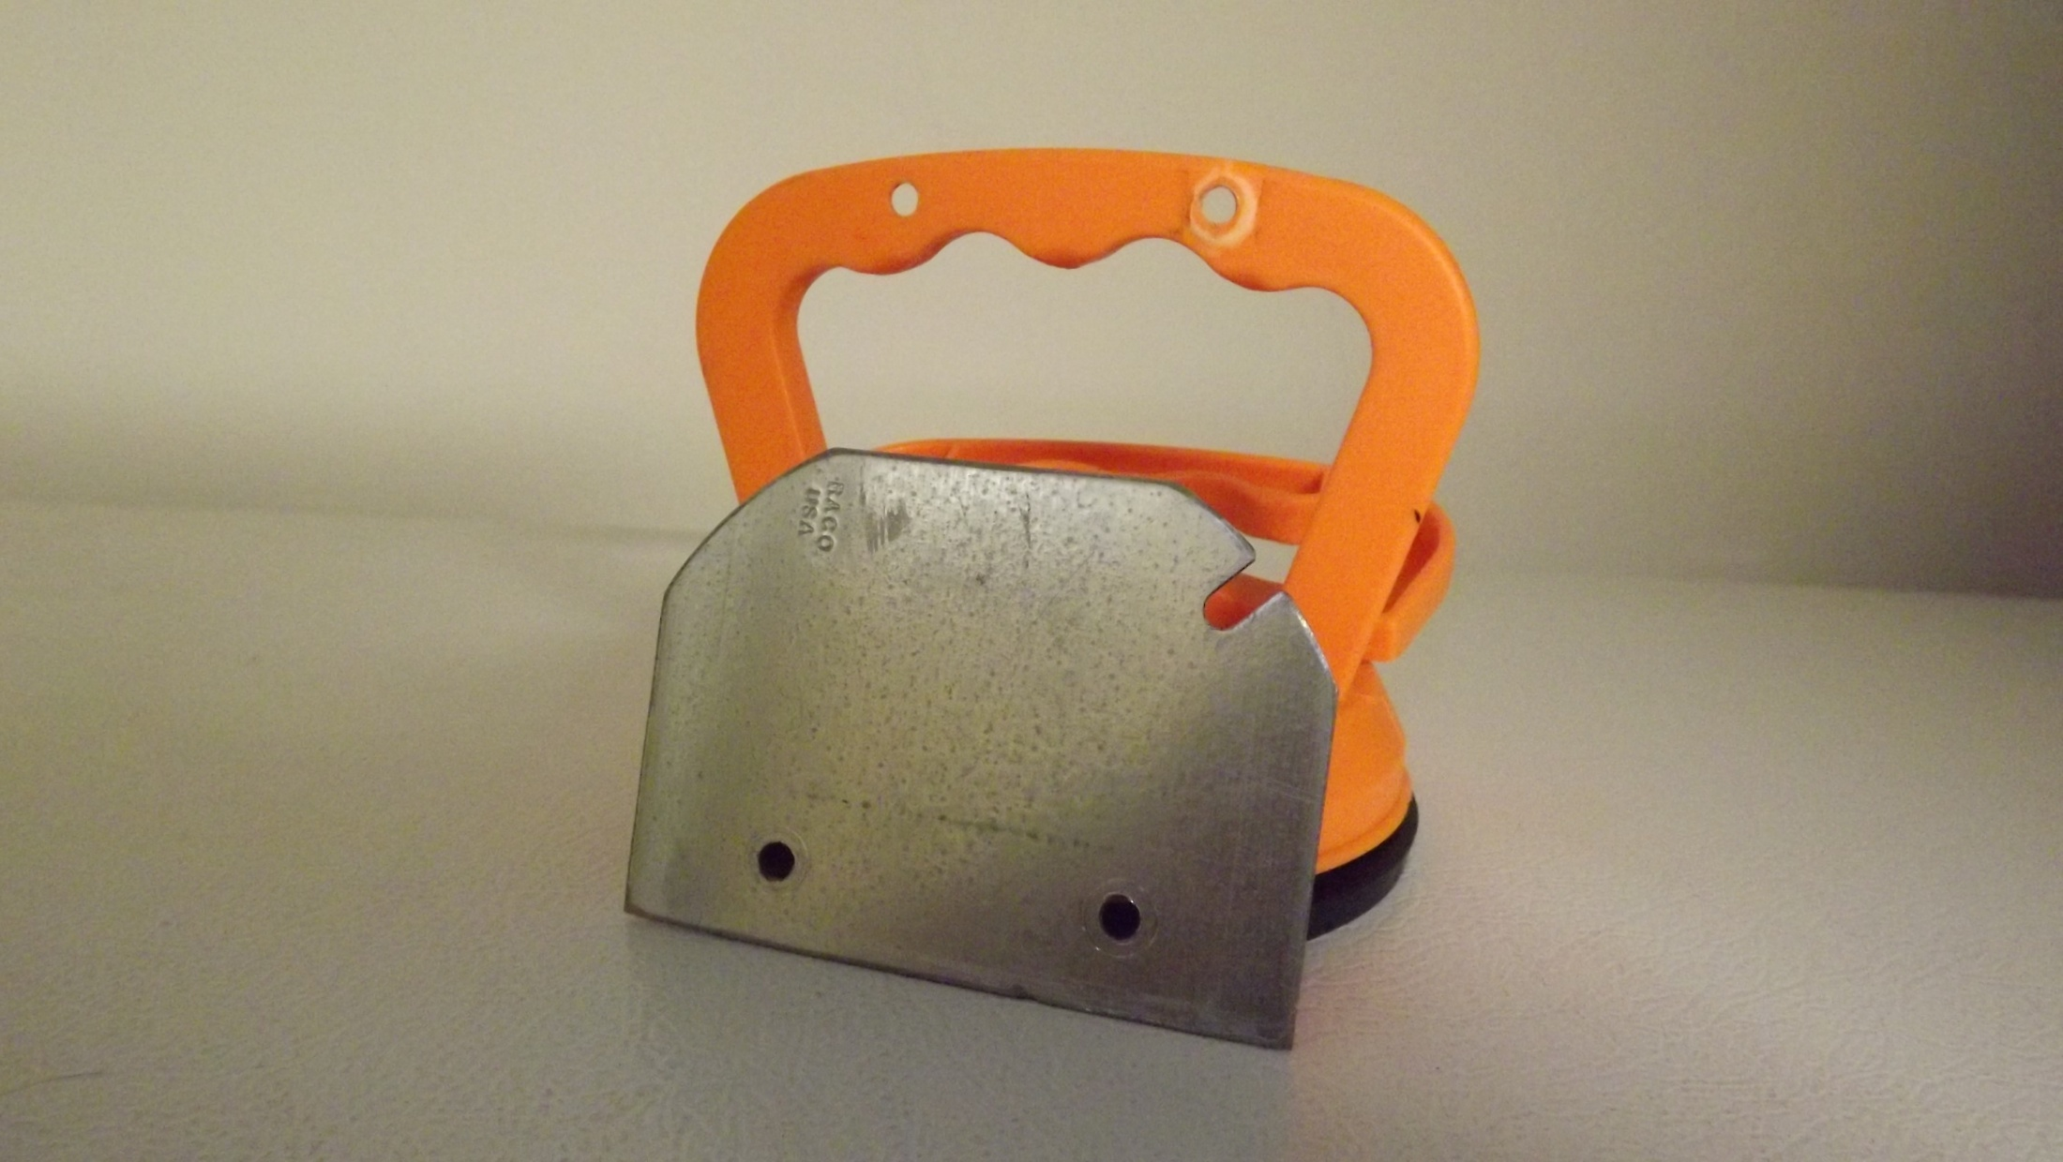

Slide 29
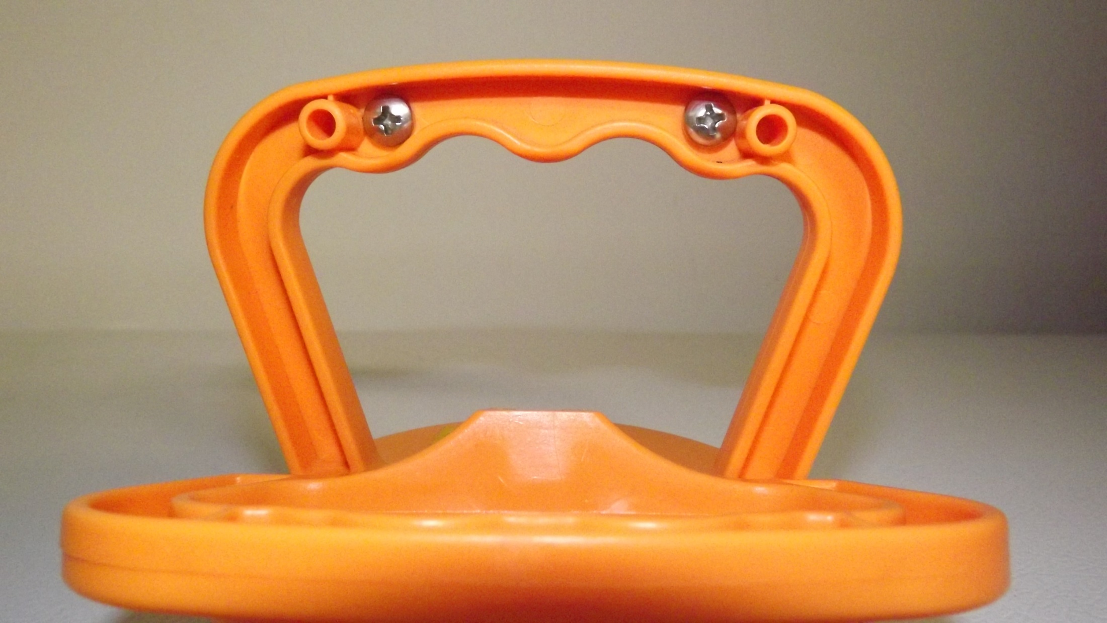

Slide 30
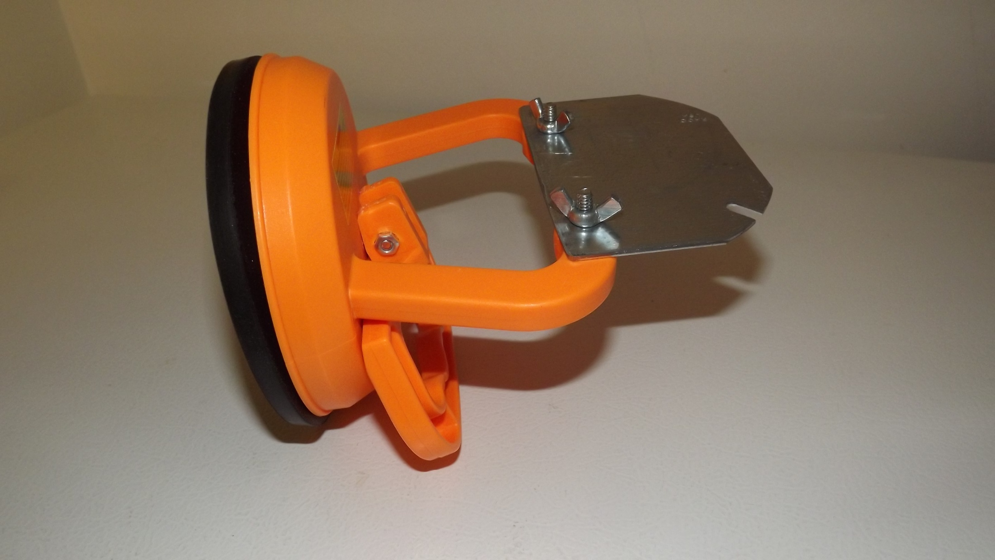

Slide 31
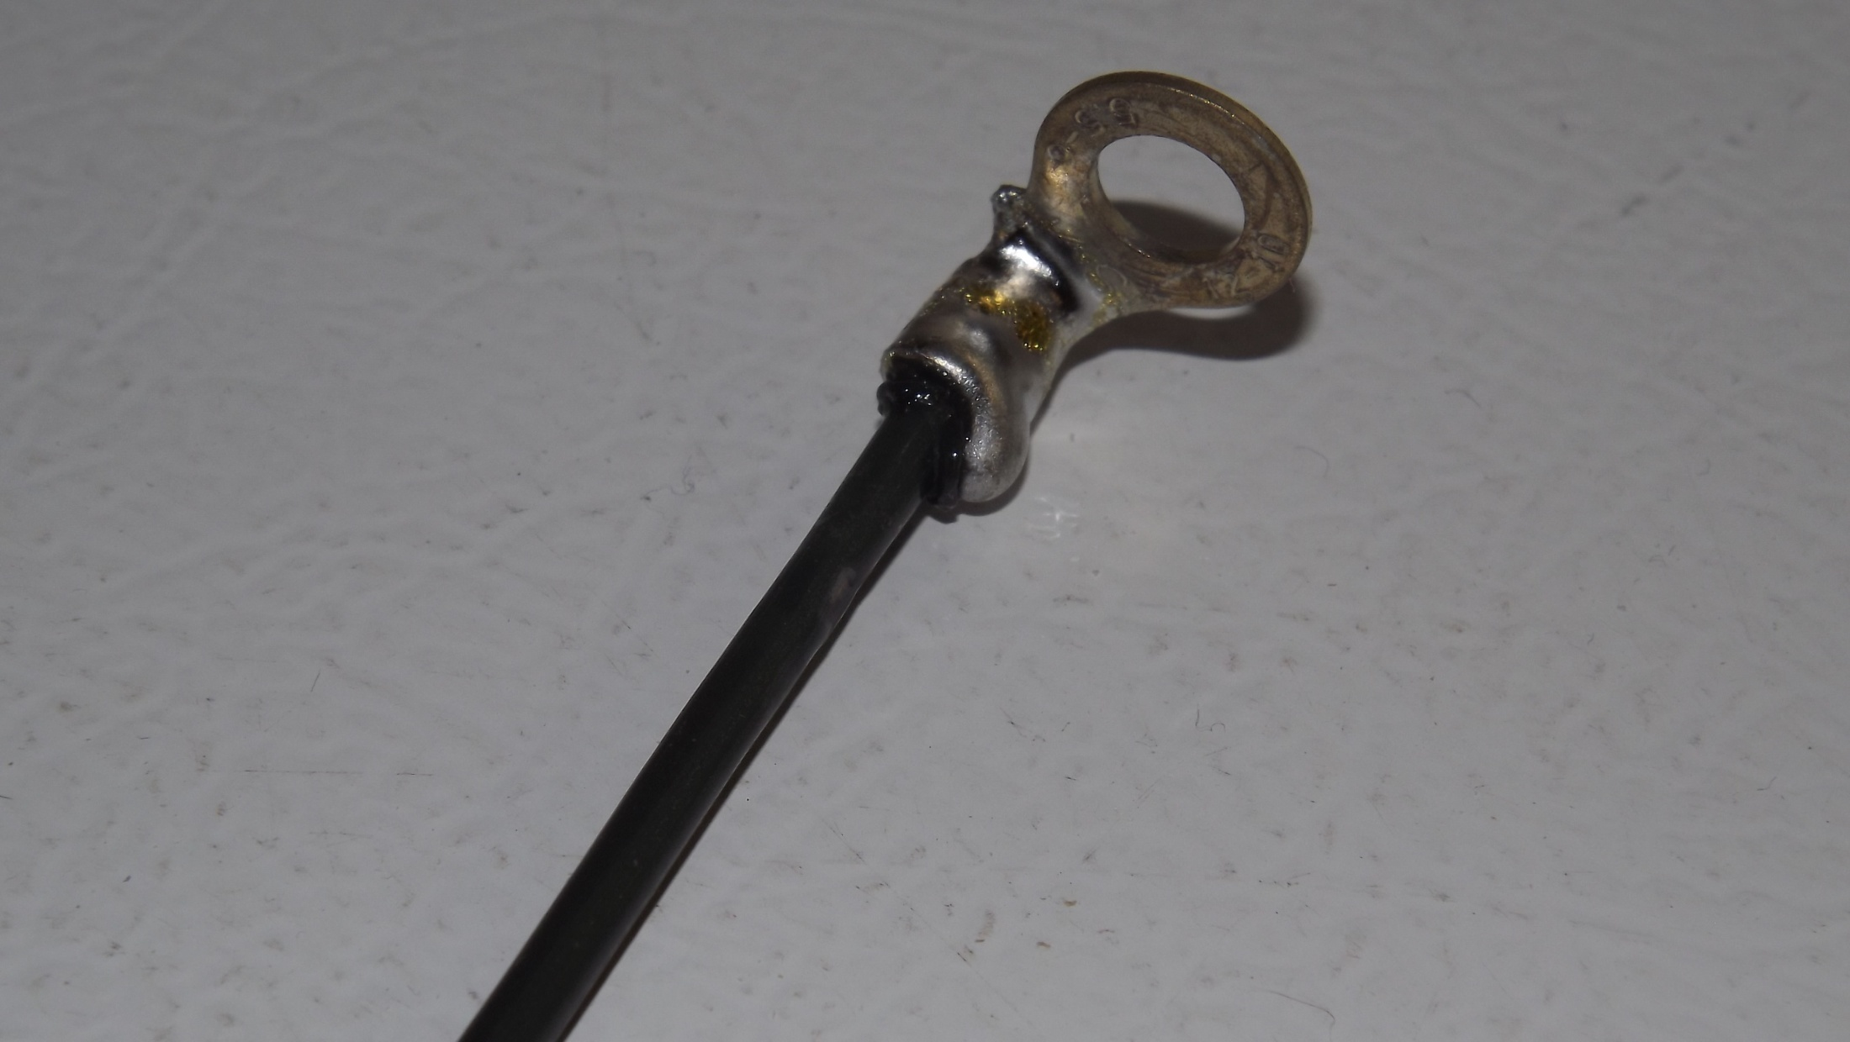

Slide 32
